Slide 1
Unit-2
Considerations for moving to cloud & Cloud Deployment

Slide 2
What is Cloud Computing?
Cloud Computing is a general term used to describe a new class of network based computing that takes place over the Internet,
basically a step on from Utility Computing
a collection/group of integrated and networked hardware, software and Internet infrastructure (called a platform).
Using the Internet for communication and transport provides hardware, software and networking services to clients
These platforms hide the complexity and details of the underlying infrastructure from users and applications by providing very simple graphical interface or API (Applications Programming Interface).

Slide 3
What is Cloud Computing?
In addition, the platform provides on demand services, that are always on, anywhere, anytime and any place.
Pay for use and as needed, elastic
scale up and down in capacity and functionalities
The hardware and software services are available to
general public, enterprises, corporations and businesses markets

Slide 4
Cloud Summary
Cloud computing is an umbrella term used to refer to Internet based development and services
A number of characteristics define cloud data, applications services and infrastructure:
Remotely hosted: Services or data are hosted on remote infrastructure.
Ubiquitous: Services or data are available from anywhere.
Commodified: The result is a utility computing model similar to traditional that of traditional utilities, like gas and electricity - you pay for what you would want!

Slide 5
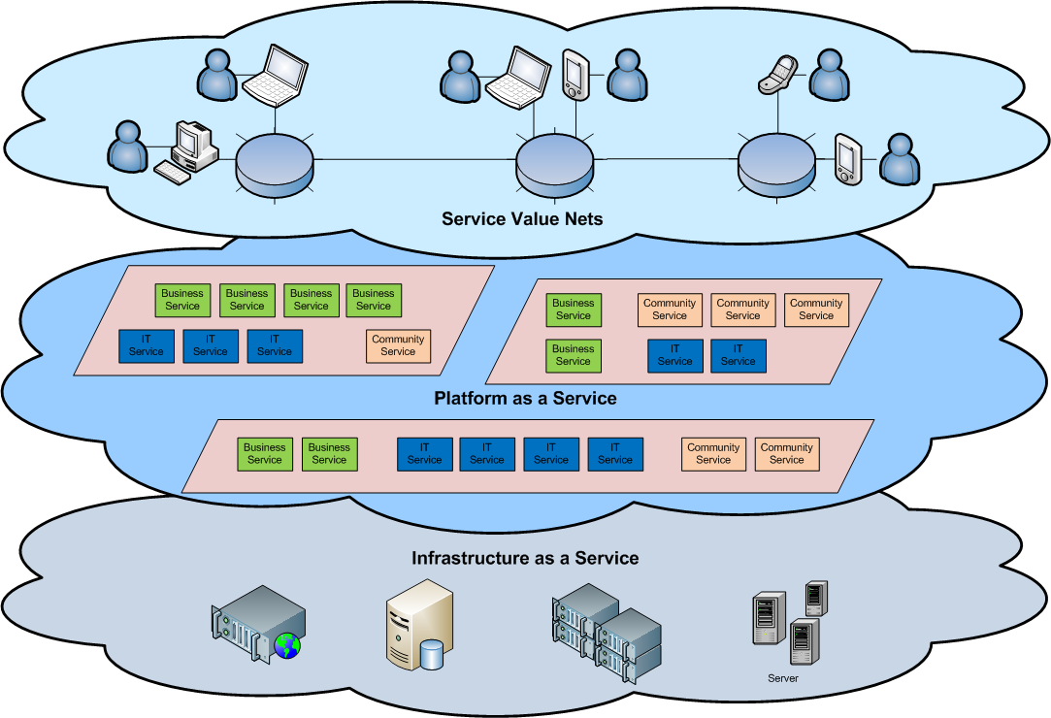
Cloud Architecture

Slide 6
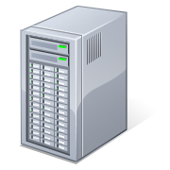
What is Cloud Computing
Applications
Services
Computer Network
Storage (Database)
SERvers
Shared pool of configurable computing resources
On-demand network access
Provisioned by the Service Provider
Adopted from: Effectively and Securely Using the Cloud Computing Paradigm by peter Mell, Tim Grance
Notes:
Cloud computing is a model for enabling convenient, on-demand network access to a shared pool of configurable computing resources (e.g., networks, servers, storage, applications, and services) that can be rapidly provisioned and released with minimal management effort or service provider interaction.
cloud computing customers do not own the physical infrastructure.
Cloud computing users avoid capital expenditure (CapEx) on hardware, software, and services when they pay a provider only for what they use.
Low shared infrastructure and costs, low management overhead, and immediate access to a broad range of applications

Slide 7
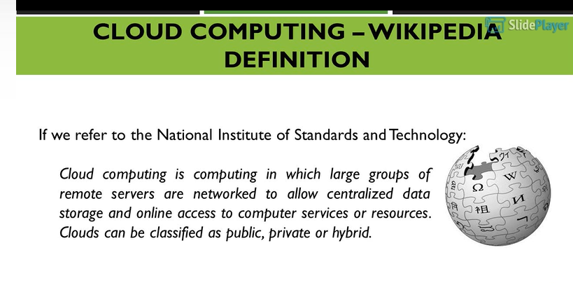

Slide 8
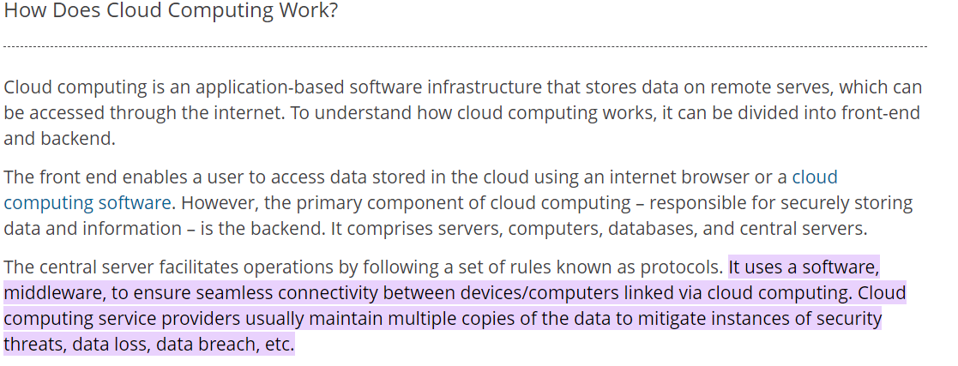

Slide 9
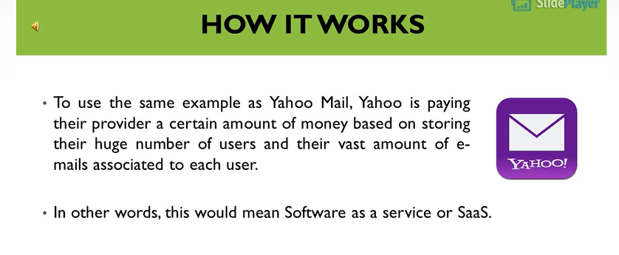
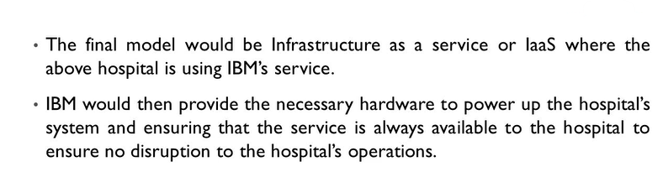

Slide 10
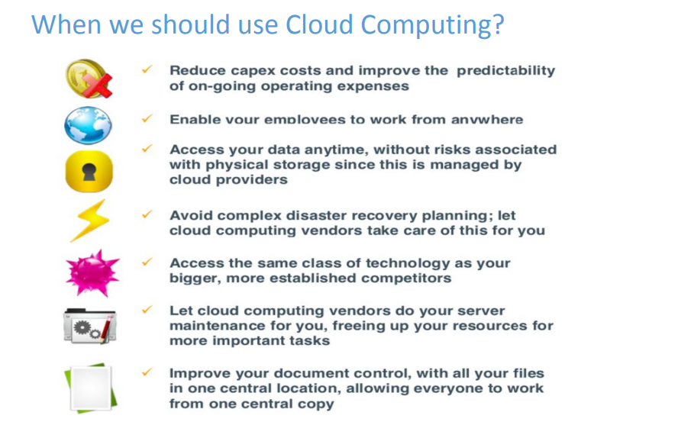

Slide 11
Scalability & Elasticity
What is scalability ?
A desirable property of a system, a network, or a process, which indicates its ability to either handle growing amounts of work in a graceful manner or to be readily enlarged.
What is elasticity ?
The ability to apply a quantifiable methodology that allows for the basis of an adaptive introspection with in a real time infrastructure.
But how to achieve these properties ?
Dynamic provisioning
Multi-tenant design

Slide 12
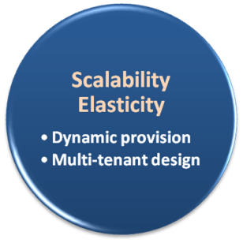
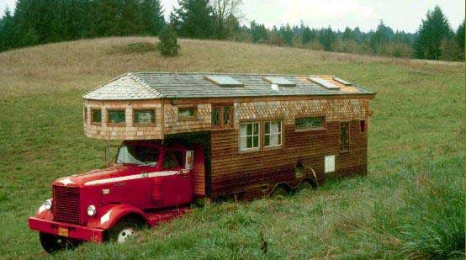
Dynamic Provisioning
What is dynamic provisioning ?
Dynamic Provisioning is a simplified way to explain a complex networked server computing environment where server computing instances are provisioned or deployed from a administrative console or client application by the server administrator, network administrator, or any other enabled user.

Slide 13


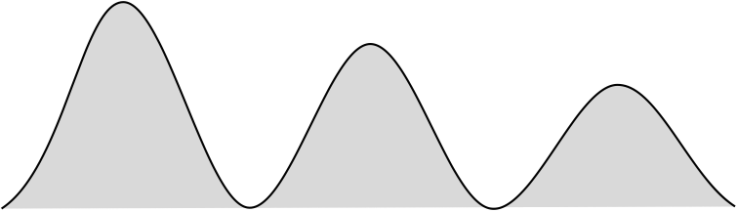

Dynamic Provisioning
In traditional computing model, two common problems :
Underestimate system utilization which result in under provision
Loss Revenue
Resources
Capacity
Resources
Demand
Capacity
1
2
3
Demand
Loss Users
Resources
Capacity
1
2
3
Time (days)
Demand
1
2
3

Slide 14
Dynamic Provisioning
Overestimate system utilization which result in low utilization
How to solve this problem ??
Dynamically provision resources
Capacity
Resources
Unused resources
Demand
Time

Slide 15
Dynamic Provisioning
Cloud resources should be provisioned dynamically
Meet seasonal demand variations
Meet demand variations between different industries
Meet burst demand for some extraordinary events
Resources
Capacity
Resources
Capacity
Demand
Demand
Time
Time

Slide 16
Multi-tenant Design
What is multi-tenant design?
Multi-tenant refers to a principle in software architecture where a single instance of the software runs on a server, serving multiple client organizations.
With a multi-tenant architecture, a software application is designed to virtually partition its data and configuration thus each client organization works with a customized virtual application instance.
Client-oriented requirements :
Customization
Multi-tenant applications are typically required to provide a high degree of customization to support each target organization's needs.
Quality of service
Multi-tenant applications are expected to provide adequate levels of security and robustness.

Slide 17
Composable business is a framework of ideas, architecture, and technology
Generally speaking, a composable business can be divided into three main components:
Composable thinking refers to the idea that business and services can be designed from components that can be quickly adapted to changes in the business environment.
Composable architecture refers to a modeling approach in which the digital architecture is built on a strong API-centric mindset, and business functions are encapsulated into interchangeable components. Composability starts from the development of the existing architecture, unlike many others that require replacement.
Composable technologies is a generic term for modern products, systems, components, microservices, or other software-based elements implemented in an API-based interconnected way.
The principles of composability can be applied either to a single component or consistently to all. The greatest business benefit is achieved by first embracing a composable paradigm, the principles of which form the basis for the development roadmap of the composable business architecture. The development roadmap provides a concrete vision of which technological solutions can be used to achieve the desired state, step by step.

Slide 18
Benefits of composable business
Speed: New product and service ideas can be brought into production much faster than in traditional development.
Adaptability: packaged capabilities allow businesses to be reorganized more quickly than traditional monolithic architectural models.
Freedom of choice: the ability to mix and match business capabilities more freely means that development can be done without compromising needs.
Resilience: packaged business capabilities consist of independent units that can be modified to make the business more resilient to turbulence in its environment.
Compatibility: the journey towards scalability can typically start by building on the existing architecture, piece by piece.
Versatility: a composable approach gives great freedom to leverage existing applications, products, and components, but leaves room for company-specific applications.
Cost benefits: once the business architecture is sufficiently implemented according to the principles of composability, the overall cost of development will decrease in the long run. This is due to its versatility and reusability.
Digital maturity: leveraging the principles of composability is a way to accelerate the growth of your organization’s digital maturity. The composability paradigm explicitly starts with business capabilities, not technology products.

Slide 19
Technologies for composable business
Composability is usually associated in a technical sense with an implementation model based on the MACH architecture. MACH architecture means microservices, API-centricity, cloud, and the use of a headless model. MACH is therefore a good representation of a technology platform that can be used to create entirely new, scalable business capabilities. However, there is much more to the composable business.
One of the advantages of composability is the freedom it allows in building a digital architecture. An organization is free to leverage off-the-shelf products and services that implement the principles of composability, build customized solutions to meet specific needs, and integrate them all into the existing digital architecture.
Opening an online shop is a simplified example of composability. The traditional way of opening an online store has been to use a variety of off-the-shelf components or products, which have been refined in terms of functionality but limited in terms of customization. Typical bottlenecks include the shopping cart process, customizability of customer interfaces, or more complex customer-specific pricing and tax rules.

Slide 20
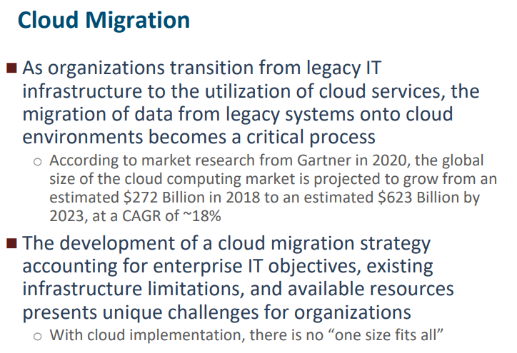

Slide 21
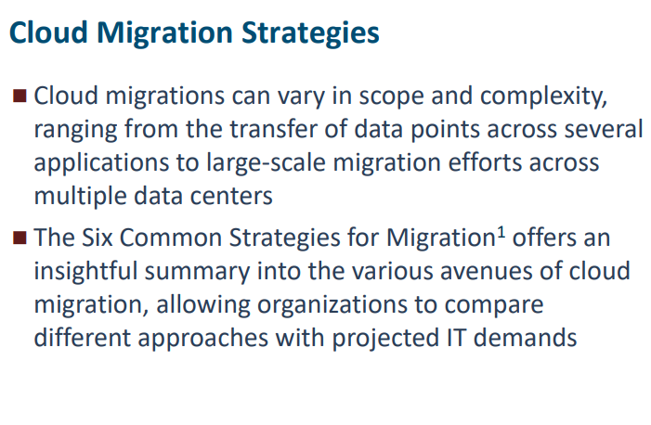

Slide 22
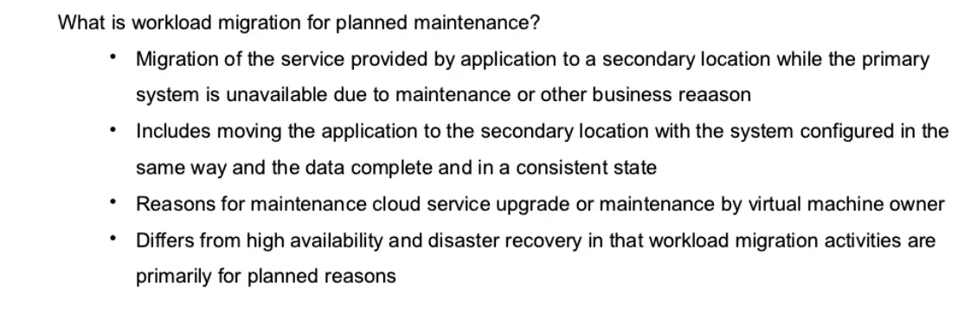

Slide 23
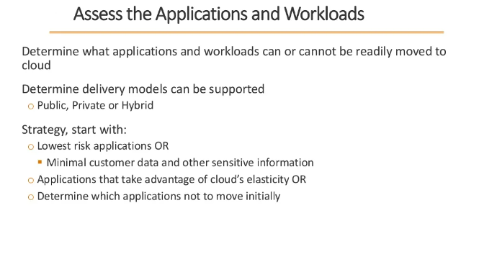

Slide 24
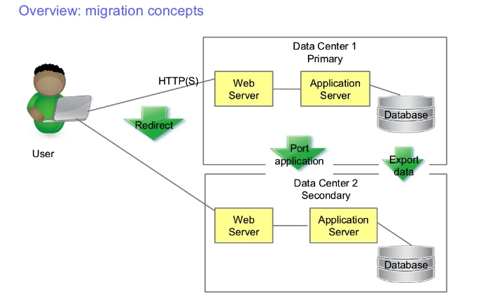

Slide 25
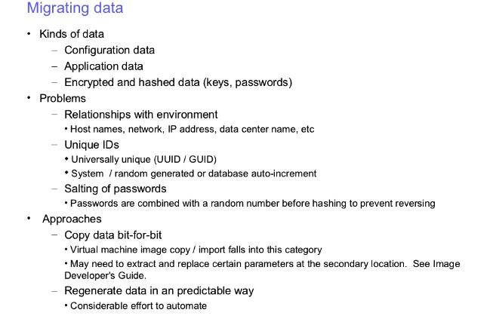

Slide 26
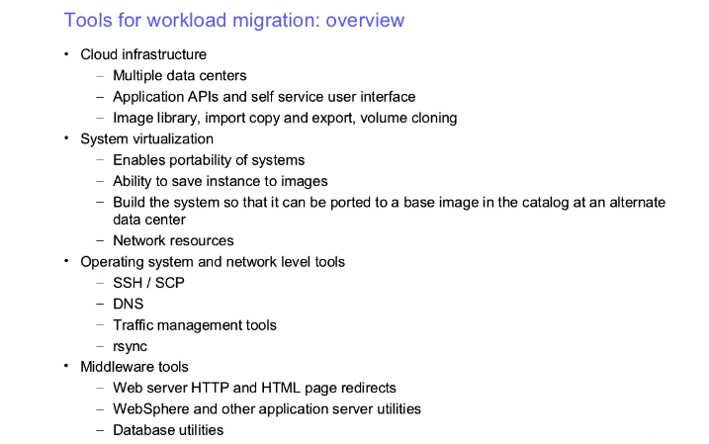

Slide 27
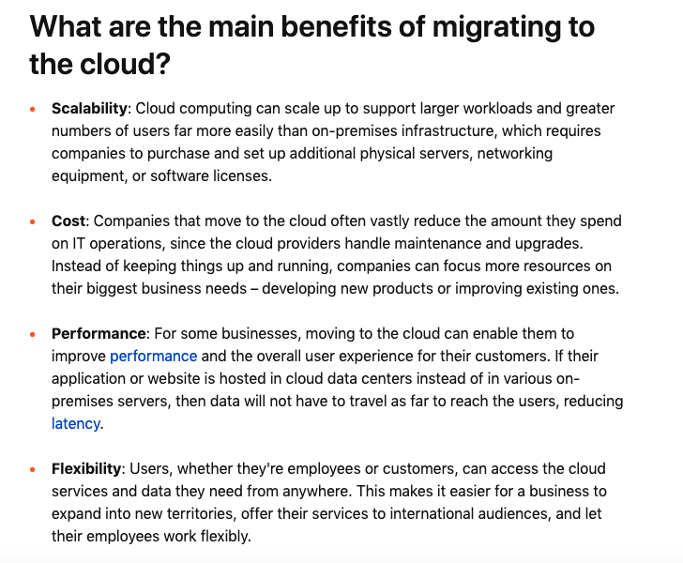

Slide 28
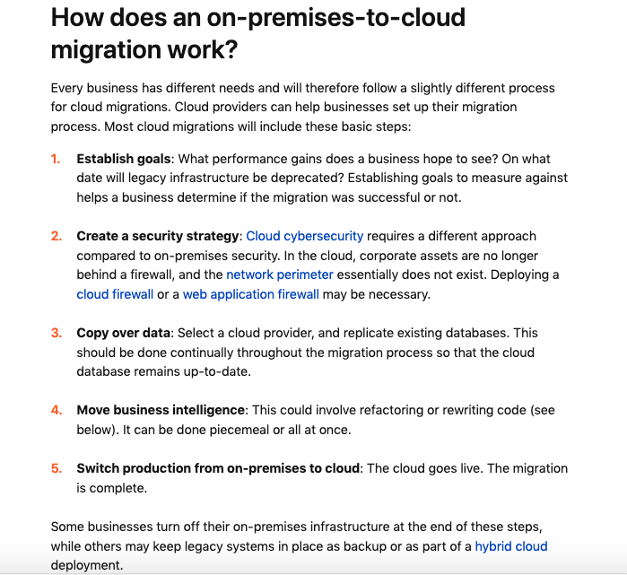

Slide 29
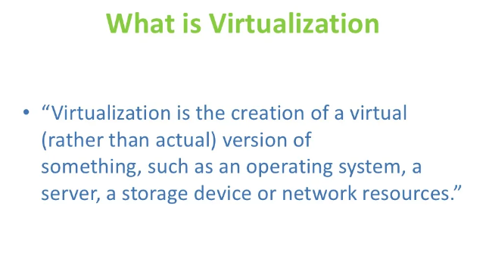

Slide 30
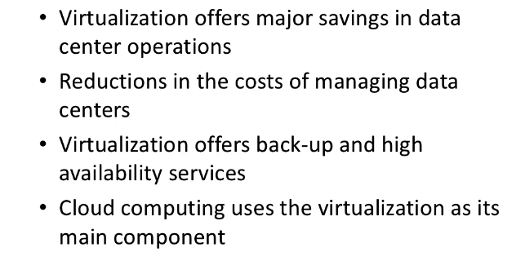
Uses of Server Virtualization

Slide 31
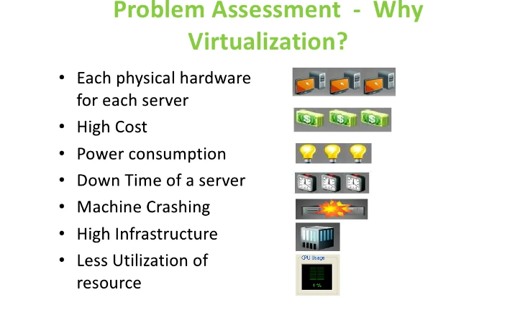

Slide 32
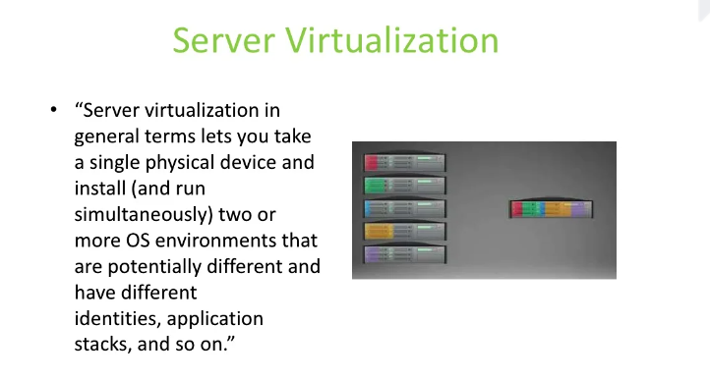

Slide 33
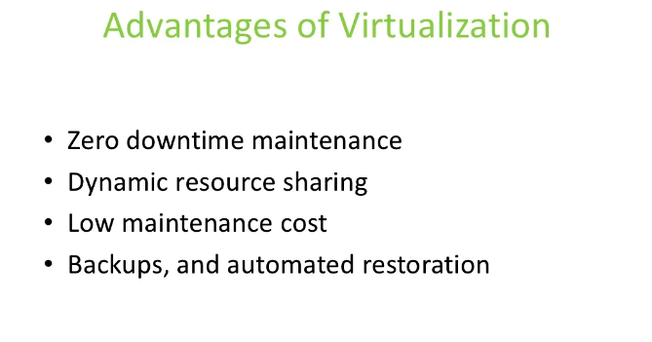

Slide 34
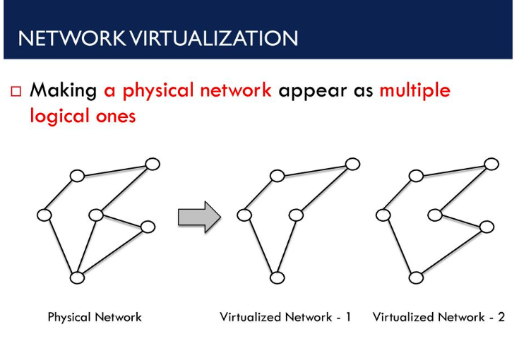

Slide 35


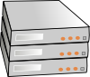
What is Network Virtualization
Ability to run multiple virtual networks that:
Each has a separate control and data plane
Coexist together on top of one physical network
Can be managed by individual parties that potentially don’t trust each other

Slide 36
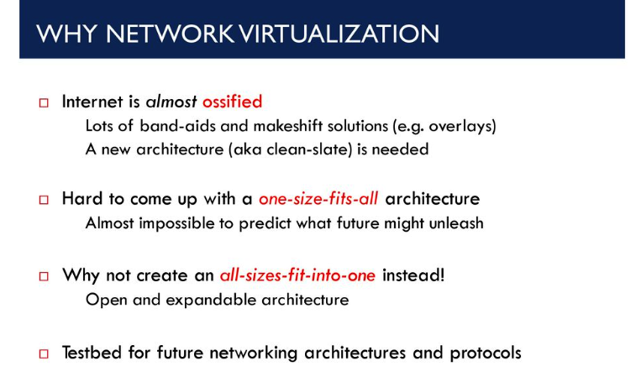

Slide 37
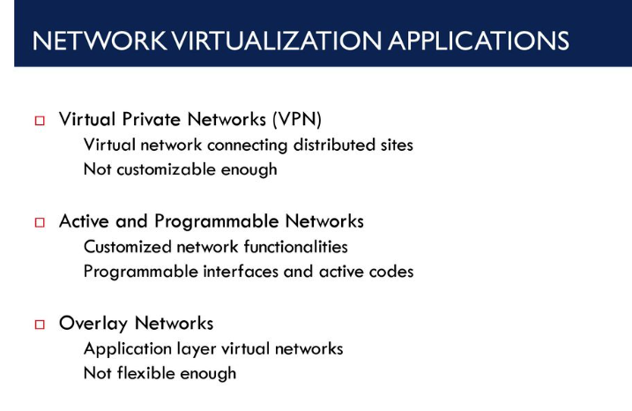

Slide 38
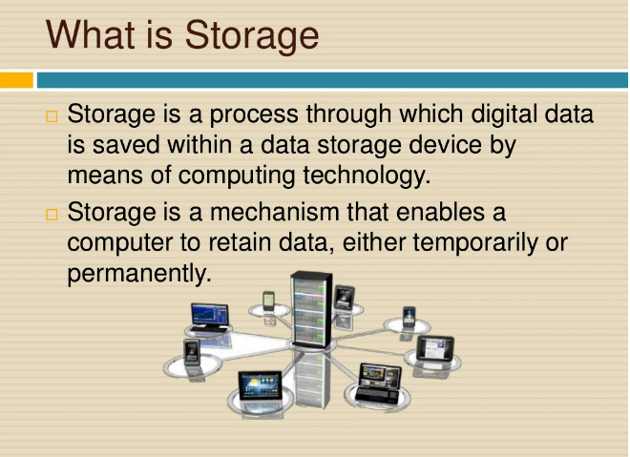

Slide 39
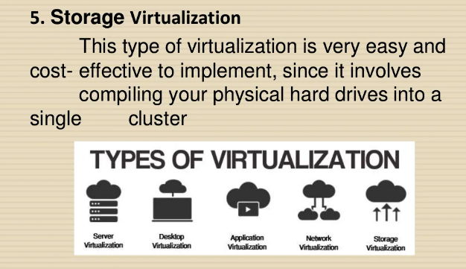

Slide 40
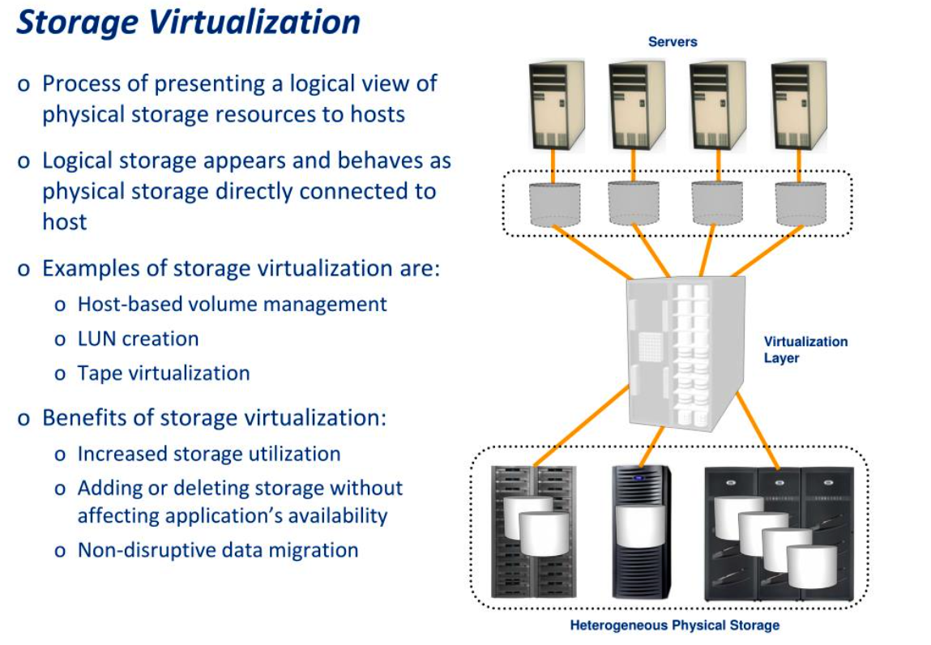

Slide 42
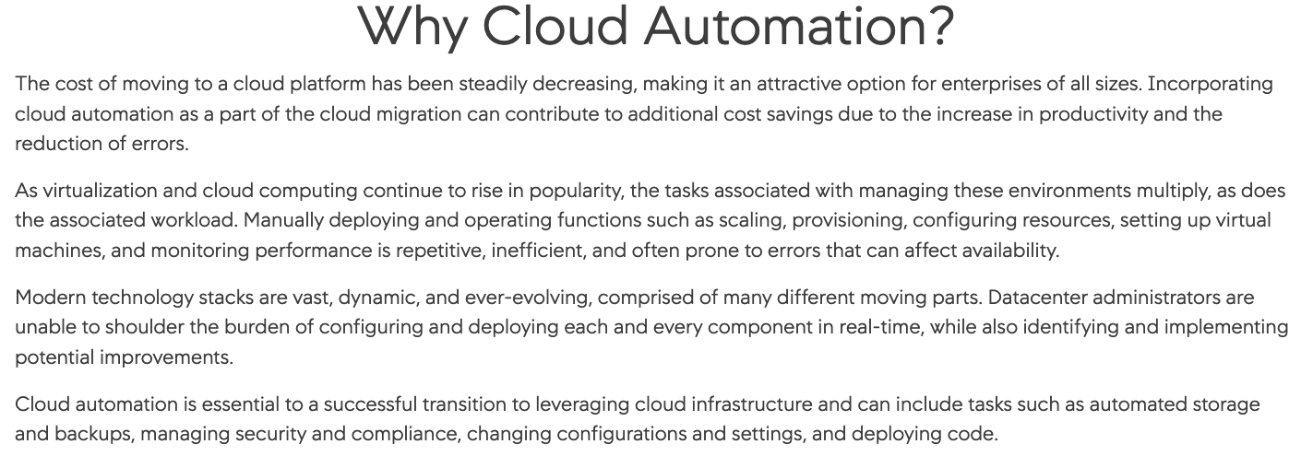

Slide 43
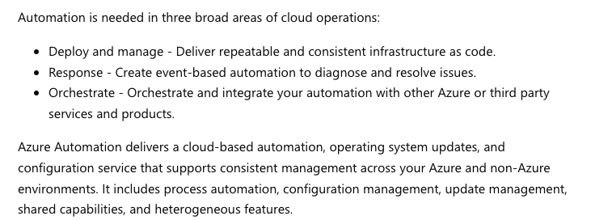

Slide 44
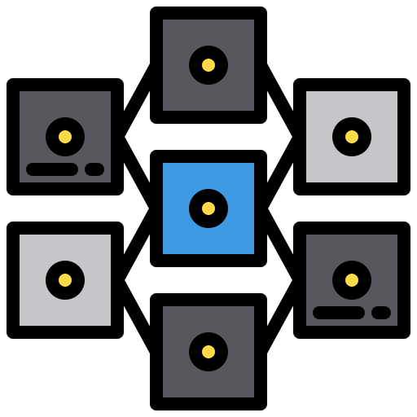
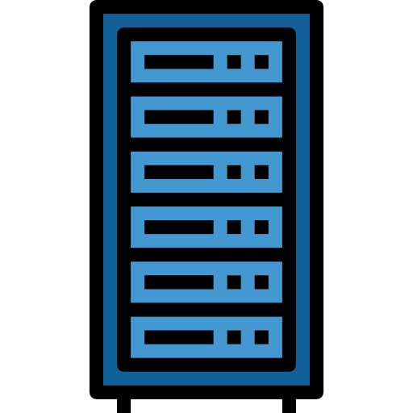

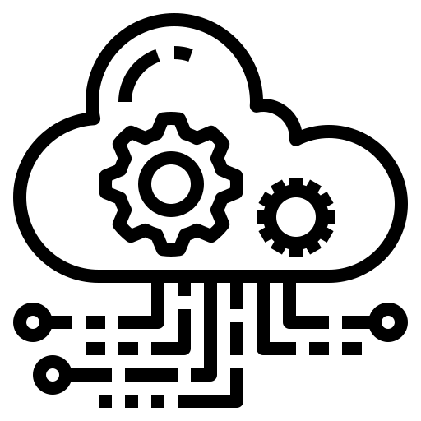
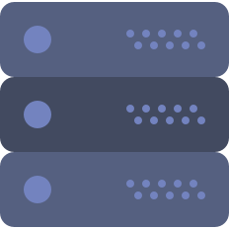
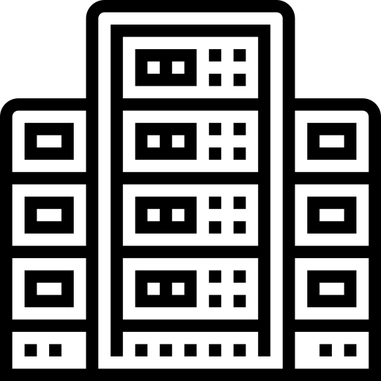
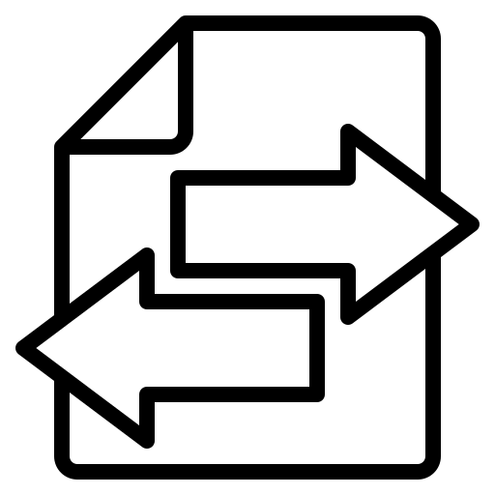
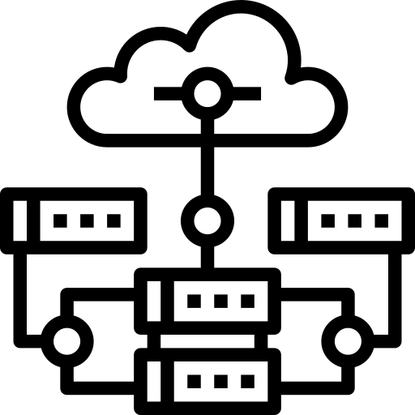
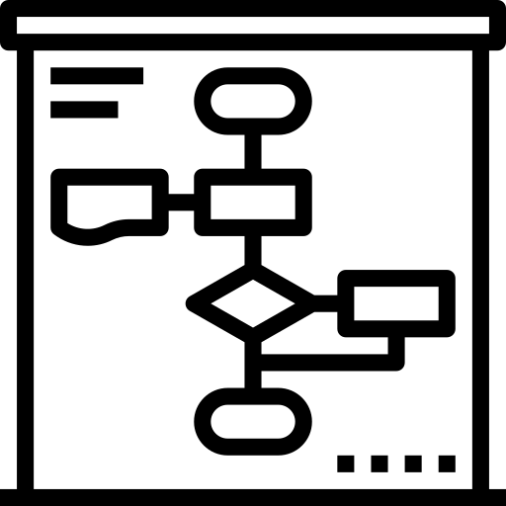
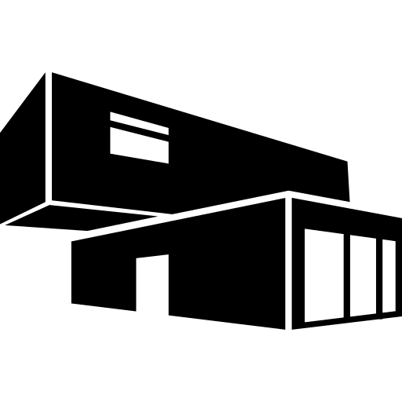
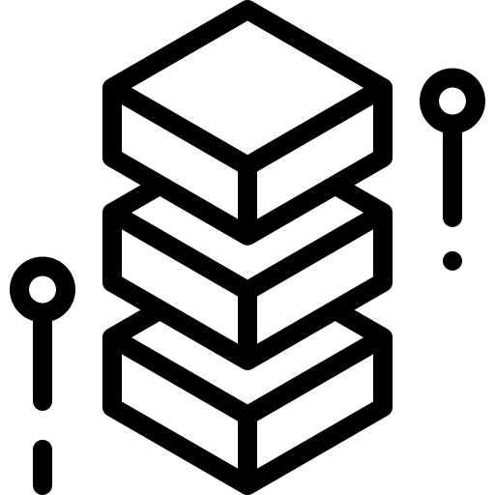
Workload Automation Architecture
DYNAMIC WORKLOAD CONSOLE
Custom applications and clients
VIEW AND OPERATE
Dashboard
Modeling
What-If
Security & configuration
Graphical views
Monitoring
Reporting
Self-service
Etherogeneous
ENGINE
Deployment options all compatible
for end-to-end configurations
Planning
REST APIs
HA/DR
ENGINE AUTOMATE WITH HA
Dynamic Scheduling
Event Management
Distributed
Mainframe
Predictive analysis
DevOps
Multitenant SaaS on IBM Cloud
DB/2 – Oracle – Informix - MS/SQL - VSAM
Automation Hub
AGENTS
AGENTLESS
Datacenter Automation
File Transfer
EXECUTE
Cloud Automation
ERP Process Automation
AIX - HP - IBMi – Linux – Solaris – Windows – z/OS -
Product license includes all features
Containers Management
DB & BigData
management
Notes:
https://www.ibm.com/marketplace/purchase/configuration/en/us/checkout?editionID=EID8ITI6

Slide 45
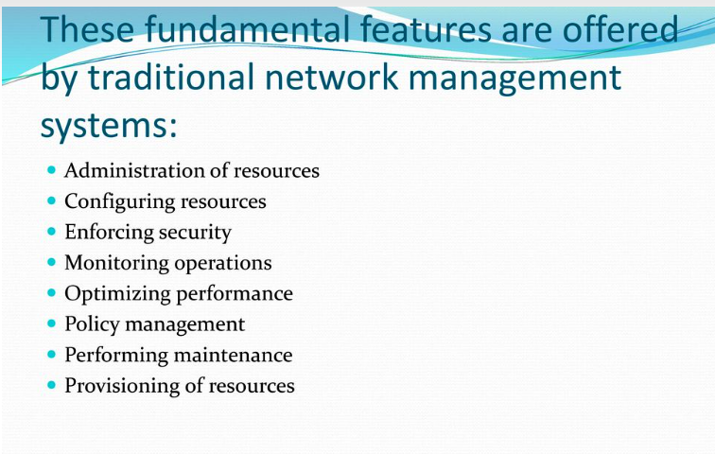

Slide 46
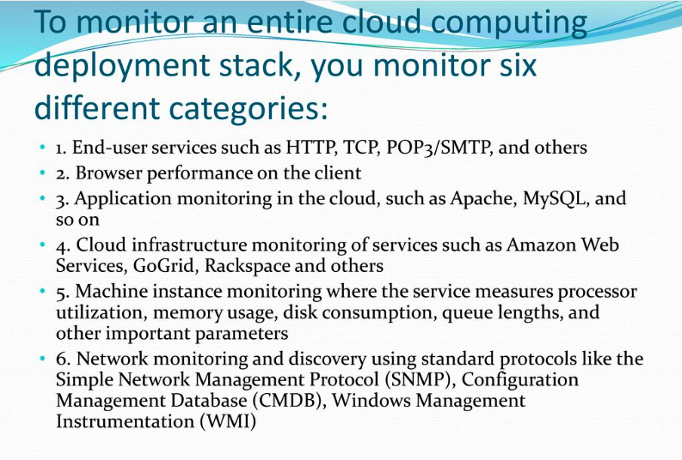

Slide 47
Types of cloud monitoring
The cloud has numerous moving components, and for top performance, it’s critical to safeguard that everything comes together seamlessly. This need has led to a variety of monitoring techniques to fit the type of outcome that a user wants. The main types of cloud monitoring are:
Database monitoring
Because most cloud applications rely on databases, this technique reviews processes, queries, availability, and consumption of cloud database resources. This technique can also track queries and data integrity, monitoring connections to show real-time usage data. For security purposes, access requests can be tracked as well. For example, an uptime detector can alert if there’s database instability and can help improve resolution response time from the precise moment that a database goes down.
Website monitoring
A website is a set of files that is stored locally, which, in turn, sends those files to other computers over a network. This monitoring technique tracks processes, traffic, availability, and resource utilization of cloud-hosted sites.
Virtual network monitoring
This monitoring type creates software versions of network technology such as firewalls, routers, and load balancers. Because they’re designed with software, these integrated tools can give you a wealth of data about their operation. If one virtual router is endlessly overcome with traffic, for example, the network adjusts to compensate. Therefore, instead of swapping hardware, virtualization infrastructure quickly adjusts to optimize the flow of data.
Virtual machine monitoring
This technique is a simulation of a computer within a computer; that is, virtualization infrastructure and virtual machines. It’s usually scaled out in IaaS as a virtual server that hosts several virtual desktops. A monitoring application can track the users, traffic, and status of each machine. You get the benefits of traditional IT infrastructure monitoring with the added benefit of cloud monitoring solutions.

Slide 48
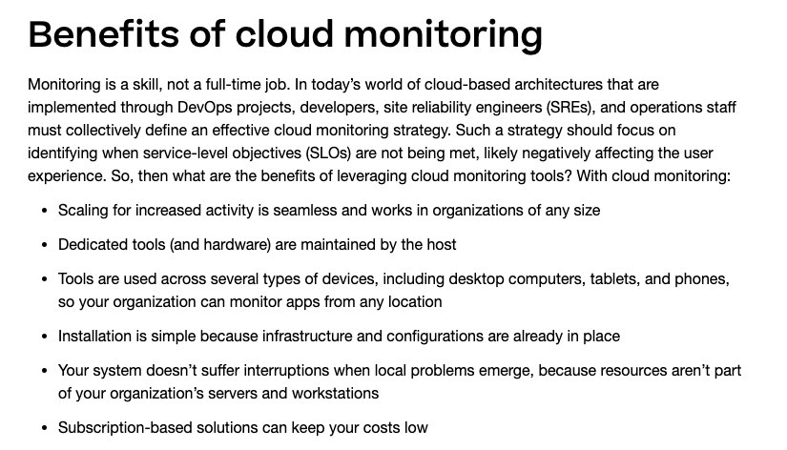

Slide 49
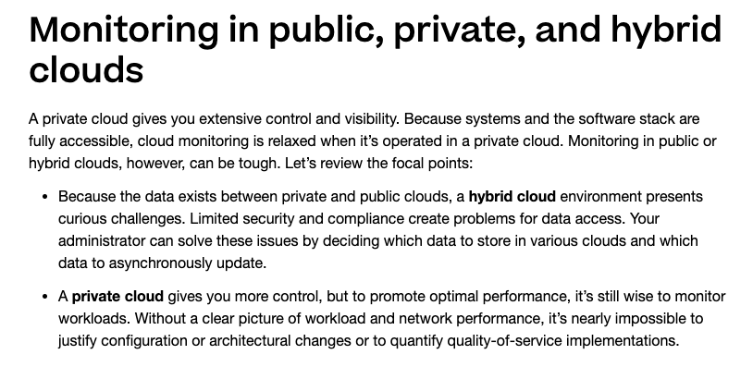

Slide 50
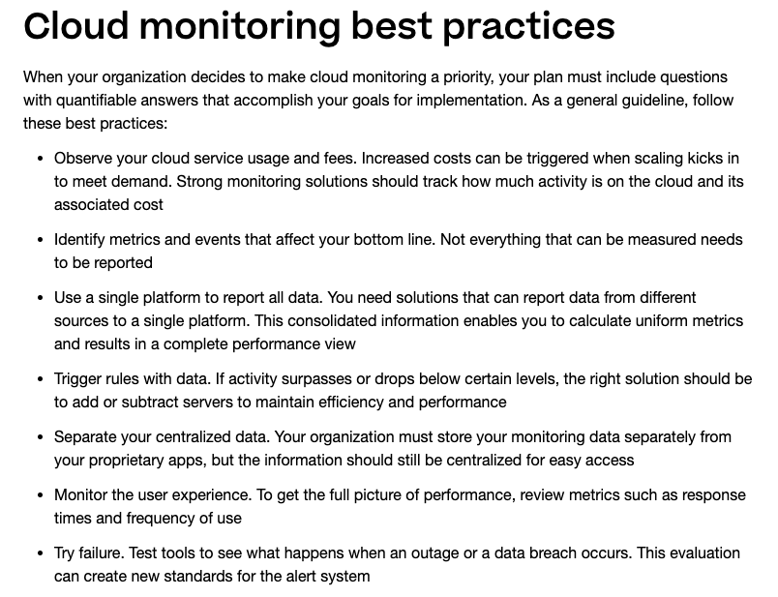

Slide 51
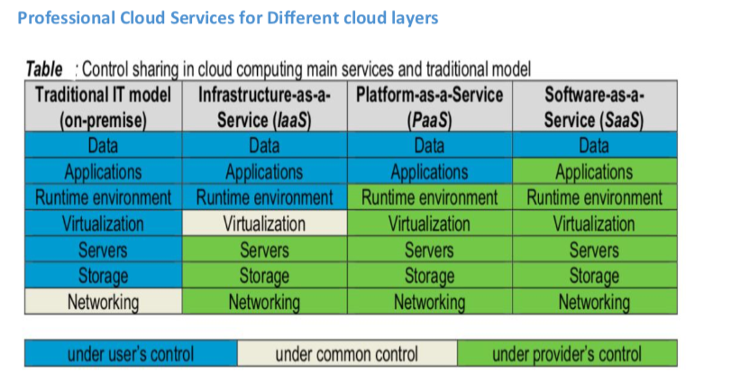

Slide 52
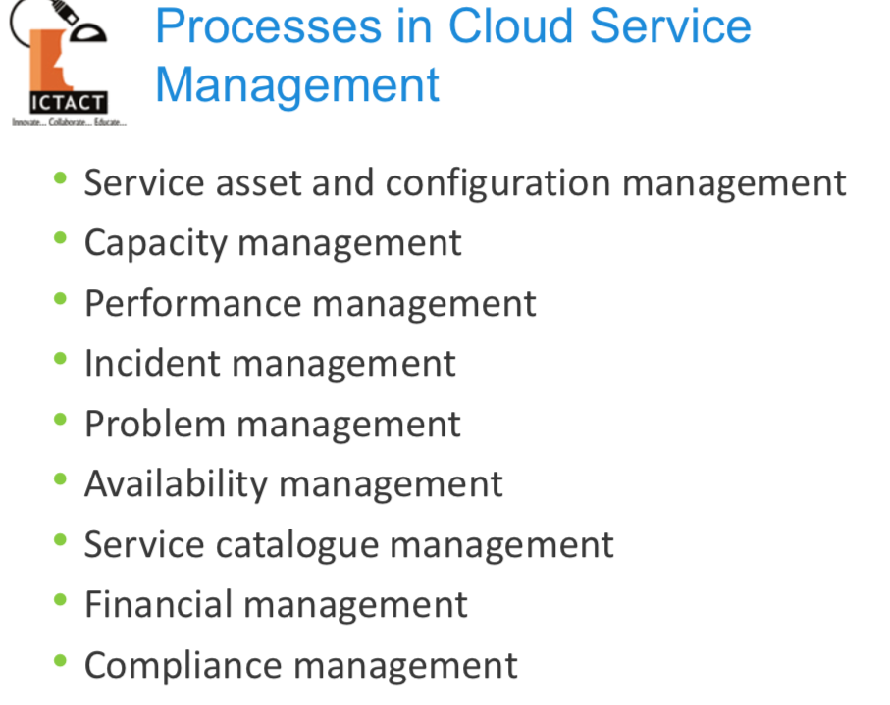

Slide 53


Slide 54


Slide 55


Slide 56


Slide 57


Slide 58


Slide 59


Slide 60


Slide 61


Slide 62


Slide 63


Slide 64
Key Considerations and Challenges Surrounding Data Sovereignty
When you expand your data to additional regions, whether for production data, data backups or disaster recovery, you must be mindful of data sovereignty.
Data at Rest
Before you give thought to your compliance, regulations, and rules, one of the initial things to consider is how and where you store your data. The first choice is whether to store data on premises or in the cloud. In the cloud, data sovereignty becomes more complex.
If you utilize the cloud, you’ll need to select options for replication and backup, which in many cases will involve storing data in another geographical location. The cloud provider may or may not allow you to select the region where backups or replicas will be stored. Ensure you are able to specify the region in which data will be stored, and understand the regulatory requirements of each region.
Data in Transit
Organizations often overlook data in transit. It helps if you consider:
How often you transfer data between geographical regions
From where and to where data is transferred
What type of data is typically transferred
You should understand this journey because it relates to how data is being collected and processed. It is especially important to understand data sovereignty in the source and destination region, and if there are legal issues, adjust your data flows to ensure data ends up in the most appropriate legal jurisdiction.

Slide 65


Slide 66
Onshore Support and Why Companies Choose It
Onshore outsourcing (also termed onsite) refers to hiring third-party companies or individuals in the same country where the business resides to perform various IT services. Typical solutions include those like Calance offers: Software Development for mobile, web and IoT; and managed services such as a 24/7 service desk, deskside support, infrastructure and security. Advanced offerings include Business Intelligence, AI, and Robotic Process Automation (RPA).
Businesses previously only had the onshore model choice, and they deployed resources onsite to work on isolated infrastructures through the completion of the project. Once the world became connected, remote work opportunities began to gain influence.
Many companies outsource their software development to onshore companies for the following reasons:
supporting their country's economy,
finding the right technical expertise, and
complying with regulatory or compliance requirements, like when data needs to reside in the country of origin.

Slide 67

Onshore Support Operations

Slide 68


Slide 69



Slide 70


Slide 71


Slide 72


Slide 73


Slide 74


Slide 75

Cloud operational changes in an Information Technology Infrastructure Library model (ITIL)

Slide 76


Slide 77


Slide 78


Slide 79


Slide 80


Slide 81


Slide 82
Operational Transformation (OT)
OT is an established consistency maintenance technique for collaborative editing systems, particularly suitable for collaborative applications running over long-latency communication networks like the Internet. OT has been widely used in both academia and industries (e.g. Google Docs4 , and CodoxWord5 ) for supporting conflict resolution and consistency maintenance of shared documents in distributed collaborative text editors, word processors, 2D spreadsheets, 3D design systems, etc. In this work, we extend OT from consistency maintenance within individual documents/files to across a collection of documents/files in a shared workspace in cloud storage. This work is inspired by the following observation: collaborative manipulation of a collection of replicated files in cloud storage can be modelled as collaborative editing of a shared workspace consisting of those replicated files; user-generated file manipulation operations can be modelled as editing operations over this shared workspace; and file synchronization in cloud storage can be mapped into consistency maintenance of the shared workspace, which OT is naturally suitable to support.

Slide 83


Slide 84


Slide 85


Slide 86


Slide 87


Slide 88

Application Migration Challenges

Slide 89

Application Migration Challenges

Slide 90

Application Migration Challenges

Slide 91

Application Migration Challenges

Slide 92

Application Migration Challenges

Slide 93


Slide 94


Slide 95


Slide 96


Slide 97


Slide 98

/Consume Vs Build Decision

Slide 99


Slide 100
5 Lessons to be learned:
Data Gravity Matters - Most transformation efforts start with an application-centric view that is driven by a mental model that applications are the center of the IT Universe and data, processes and infrastructure revolve around applications. I believe that over the past few years data has evolved to be at the center of the IT universe. Any enterprise should understand the data at the core of its business and establish where it resides on the hybrid cloud before embarking on a cloud transformation.
Engineer Security and Privacy into your Cloud - As data has become the core asset of any enterprise, it has also become the primary target for criminals. Securing data and enforcing the privacy of data should be a primary design point of a hybrid cloud architecture. A data-centric approach to a transformation drives how you engineer how to a) build a defense in depth b) build a highly automated security architecture c) design for data sovereignty d) instrument dynamic monitoring, logging, and auditing function to ensure regulatory compliance and prevent IAM creep in your cloud implementation.
Focus on your developers – The first decade of Cloud computing optimized the IT infrastructure spend and enable infrastructure agility within the enterprise. Hybrid Cloud Architectures should build on these gains and deliver business agility to sense and respond to rapid and continuous changes in the marketplace. These architectures should deliver intelligent and configurable business processes that are built using microservices, low code development tools, and a developer-friendly platform to empower developers to build and compose applications anywhere and deploy them everywhere.
Build what you can support - While many CIOs focus on the technologies and cloud providers, I have learned that it is more important to focus on the capabilities (skills and processes) in the IT organization to build, manage and sustain the advantages gained from the transformation. Building a learning organization that can continue to learn and adapt to the rapidly changing cloud technology landscape is the key predictor of the success of a Cloud Transformation.
Focus on Total Cost of Ownership - Leaders spend time focusing on highly visible costs such as licensing costs or the affordability of IaaS. Instead, they should focus on the total cost of ownership of a cloud solution including network costs, operational costs, the investments required in continuous re-skilling, and the real shortage of qualified architects who understand the benefits of engineered and optimized cloud architecture and site reliability engineering.

Slide 101



Slide 102


Slide 103


Slide 104


Slide 105


Slide 106


Slide 107

The releases of top cloud computing trends that have been most dominant

Slide 108

The releases of top cloud computing trends that have been most dominant

Slide 109

The releases of top cloud computing trends that have been most dominant

Slide 110

The releases of top cloud computing trends that have been most dominant

Slide 111


Slide 112


Slide 113


Slide 114


Slide 115


Slide 116


Slide 117


Slide 118
Business Continuity Process
Perform Business Impact Analysis
Prioritize services to support critical business processes
Determine alternate processing modes for critical and vital services
Develop the Disaster Recovery plan for IS systems recovery
Develop BCP for business operations recovery and continuation
Test the plans
Maintain plans
Notes:
118
Some business processes are more important than other business processes. Sales is more important in the short term than engineering, and possibly more than the factory. That is why business processes are prioritized.
118

Slide 119
Benefits of cloud business continuity
There are numerous benefits to using the cloud for business continuity (BC). The most obvious is that on-premises workloads can be configured to fail over to the cloud, substantially reducing an organization's downtime. This enables mission-critical applications to run even if the organization experiences data center issues.
The cloud also simplifies disaster recovery (DR) planning. On-premises continuous data protection offerings can often be configured to write a backup copy to the cloud. This ensures that critical data is replicated to an off-site location where it's protected against disasters that might affect the data center. An organization could also use a cloud-based disaster recovery service, which can be a less expensive and simpler alternative to a custom cloud-based DR offering.

Slide 120


Slide 121
Selecting a cloud Disaster Recovery (DR) provider
Selecting a cloud DR provider typically involves six separate considerations: location, reliability, scalability, security and compliance.
First, a business must consider the cloud DR provider's physical distance and latency putting DR too close increases the risk of shared physical disaster, but putting the DR too far away increases latency and network congestion, making it harder to access DR content. Location can be particularly tricky when the DR content must be accessible from numerous global business locations. Next, consider the cloud DR provider's reliability. Even a cloud experiences downtime, and service downtime during a recovery can be equally disastrous for the business.

Slide 122
Benefits of cloud Disaster Recovery
Cloud Disaster Recovery provides several important benefits when compared to more traditional DR strategies:
Pay-as-you-go options. Organizations that deployed do-it-yourself (DIY) DR facilities faced significant capital costs, while engaging managed colocation providers for off-site DR services often locked organizations into long-term service agreements. A major advantage of cloud services is the pay-as-you-go paradigm, which enables organizations to pay a recurring monthly charge only for the resources and services that are used. As resources are added or removed, the payments change accordingly.
Flexibility and scalability. Traditional DR approaches, usually implemented in local or remote data centers, often imposed limitations in flexibility and scalability. The business had to buy the servers, storage, network gear and software tools needed for DR, and then design, test and maintain the infrastructure needed to handle DR operations -- substantially more if the DR was directed to a second data center. This typically represented a major capital and recurring expense for the business.
High-reliability and geo-redundancy. One essential hallmark of a cloud provider is a global footprint, ensuring multiple data centers to support users across major global geopolitical regions. Cloud providers use this to improve service reliability and ensure redundancy. Businesses can readily take advantage of geo-redundancy to place DR resources in another region -- or even multiple regions -- to maximize availability. The quintessential off-site DR scenario is a natural trait of the cloud.
Easy testing and fast recovery. Cloud workloads routinely operate with VMs, making it easy to copy VM image files to in-house test servers to validate workload availability without affecting production workloads. In addition, businesses can select high bandwidth and fast disk I/O (input/output) options to optimize data transfer speeds to meet recovery time objective (RTO) requirements. However, data transfers from cloud providers impose costs, so testing should be performed with those data movement -- cloud data egress -- costs in mind.

Slide 123


Slide 124
What are the business benefits of cloud deployment?
With an effective cloud deployment model, an organization achieves numerous benefits, including:
Faster and simplified deployments. Automate builds that deploy code, databases and application releases, including resource provisioning.
Cost savings. Control costs using consumption-based pricing and eliminate capex-heavy on-premises environments.
Platform for growth. Leverage the global infrastructure provided by cloud service providers (CSPs) to seamlessly expand the business into other geographies.
New digital business models. Exploit the continuous release of features and services by CSPs, incubate new technologies and innovate digital business models.
Business resiliency. Architect for the availability and fault-tolerance CSPs offer and ensure disaster recovery and business continuity of applications to make the business resilient.
Agility and scalability. Use autoscaling and scalability to meet peak demands of the business without provisioning for excess capacity.
Geographic reach. Access applications from any location, on any device, leveraging the connectivity backbone of CSPs.
Operational efficiency. Use the inherent automation enabled by cloud to increase operational efficiency and reduce human effort.
A competitive edge. Leverage infrastructure as code and development, security and operations (DevSecOps) to reduce the time to market for new features and stay ahead of the competition.
Empowered users. Increase productivity by empowering users with self-service options on cloud, such as portals, DevOps pipelines and executive and operational dashboards.

Slide 125


Slide 126
Cloud deployment overview
Working with Microsoft to deploy finance and operations apps in the cloud requires that you understand the environment and subscription that you are deploying to, who can perform which tasks, and the data and customizations that you need to manage. We recommend that you sign up for the Full Microsoft FastTrack for Dynamics 365 to help speed your deployment and implementation - it's a program that provides training and consulting to help you realize business value faster. For more information, see Microsoft FastTrack. If you choose to use the Essentials FastTrack program instead, you will be using the Implementation Project Methodology in Lifecycle Services (LCS) to help you manage your implementation project.

Slide 127


Slide 128


Slide 129
Thank You!
Q&A?

